Slide 1
Customer retention data analysis
Name : Atish GOUNDADKAR

Slide 2
Project objective
Customer satisfaction has emerged as one of the most important factors that guarantee the success of online store; it has been posited as a key stimulant of purchase, repurchase intentions and customer loyalty. The data is collected from the Indian online shoppers. Results are to indicate the success of e-retails and online stores.

Slide 3
EDA ANALYSIS APPROACH
Understanding the Data: We have used the Jupyter Python Notebook to load and understand the datasets for both Current Applications & Previous Applications. We have gone through the breadth & the depth of the attributes present in the datasets along with their definition to understand the data quality & its spread at a high level.
• Data Preparation/Cleaning: After a clear understanding of the problem statement & the given datasets, we moved to the most critical & an essential part of this project i.e. Data Clearing & preparing the data for further analysis. In.
• Data Analysis: Finally, we performed various types of Univariate, Bivariate analysis by plotting appropriate graphs . This helped us to draw relevant insights. We will categories the EDA process with phases
(i) Customer approach towards the e-shopping, devices they prefer , age category etc.
(ii) Application they use , time they spend , operating systems they use etc.
(iii)Reviews about ease of accessing , responsive benefits, customer satisfaction, product information etc.
(iv)Preferred websites/online store on site performance,offers,relaiblity,quickness,delivery,security,payment mode etc.

Slide 4
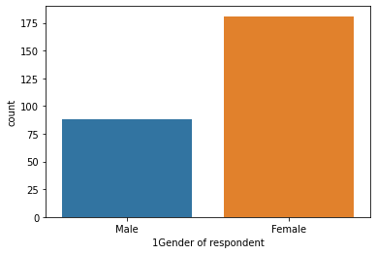
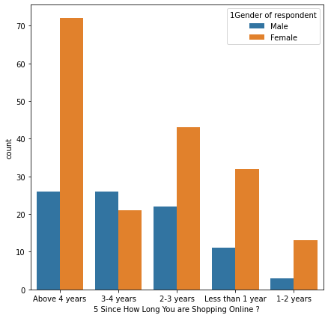
1 - Customer approach towards the e-shopping, devices they prefer , age category etc.
The Fig.I Female customers are twice as of the male customers preferring to online stores for shopping.
Fig.2 Majority of customers are shopping for more than 4 years very few customers have started shopping in past 1-2 years .Good number of customers have started shopping from last year.

Slide 5
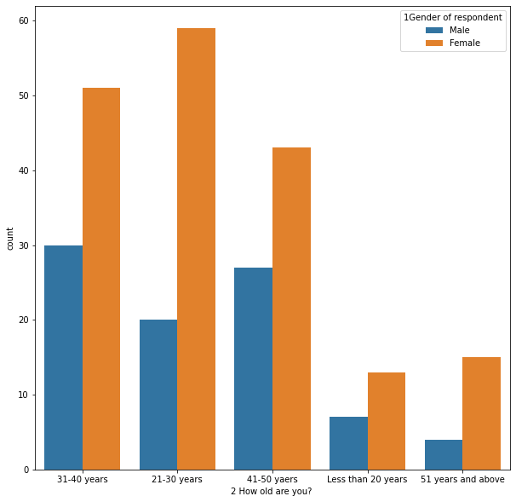
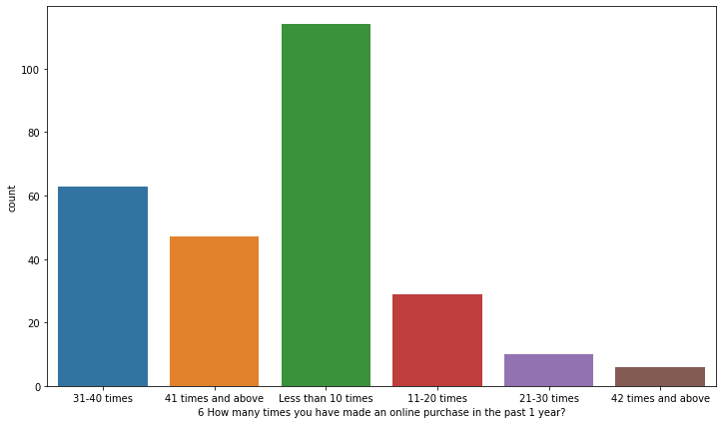
The Fig.1 Most of the customers are from 21-30 age also in all age category females are more in number,
Fig.2 100 plus customers have done shopping less than 10 times in past 1year, also more than 60 customers have shopped for 31-40 times in past 1 year.

Slide 6
The Fig.1 Most of the customers are from 21-30 age also in all age category females are more in number,
Fig.2 Most of the customers have done shopping less than 10 times in past 1year, also more than 60 customers have shopped for 31-40 times in past 1 year.

Slide 7
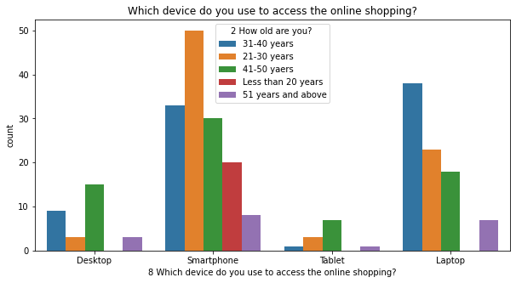
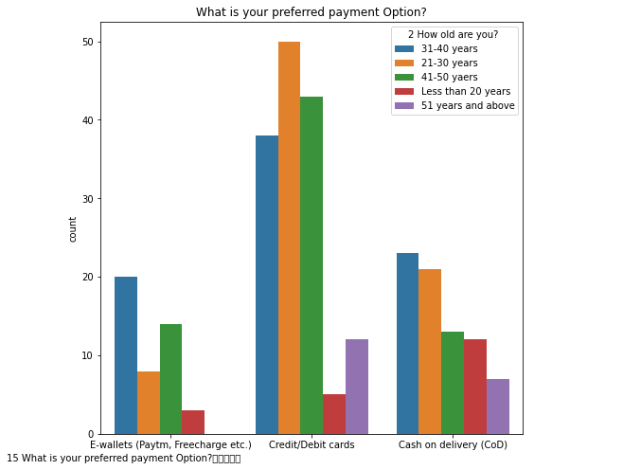
The Fig.1 Smartphone is used by all age category customers for shopping ,customers less than 20 years don’t use any other gadget than smartphone . Age category 31-40years highly opt for laptop.
Fig.2 Credit/Debit cards payment option is opted by all age categories. E-wallet is least opted and customers above 51years don’t even prefer that option.

Slide 8
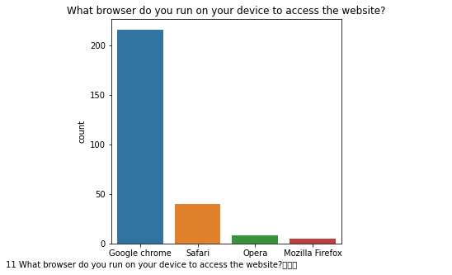
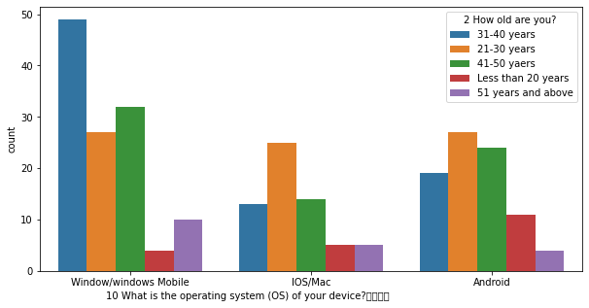
(ii) Application they use , time they spend , operating systems they use etc.
The Fig.I Close to 75% of customers browse the websites through Google chrome very few opt for Mozilla Firefox, safari and opera.
Fig.2 Windows/Windows mobile is preferred OS and customers from 21-30years are more in numbers as they prefer using laptop. Average number of customers use android OS system. IOS/MAC is used by few customers.

Slide 9
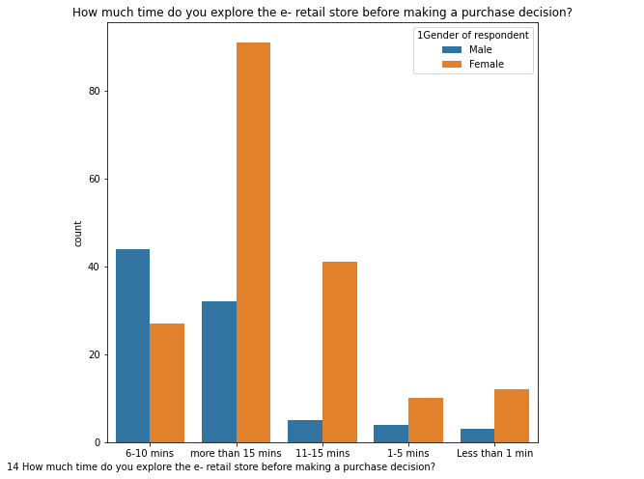
The Fig.1
Most customers tend to spend more than 15minutes before purchasing any goods within that female customers are more than twice the male customers.Male customers generally spend 6-10 mins before buying .Very customers spend less than 5 mins time before confirming the buying .

Slide 10
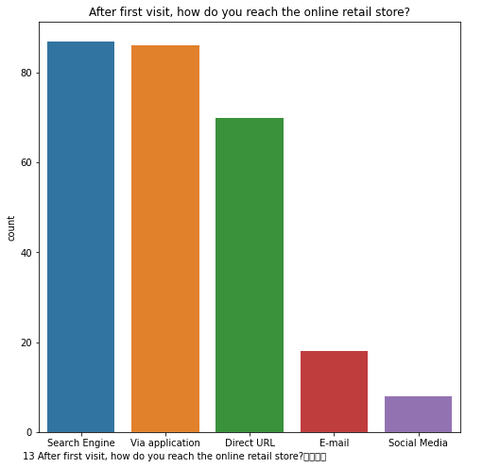
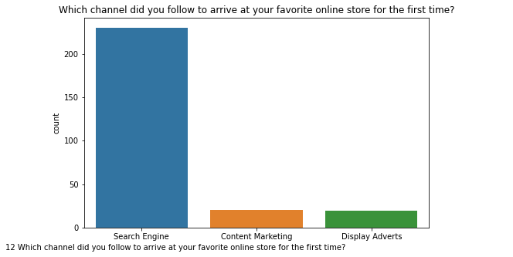
The Fig.1 Customers use search engine for first time to access their favorite site for first time. Very few customers arrive through content marketing and display advertise.
The Fig.II After first visit of e-store, good number of customers opt store application or direct URL to reach. Very few customers reach through social media and E-mail.

Slide 11
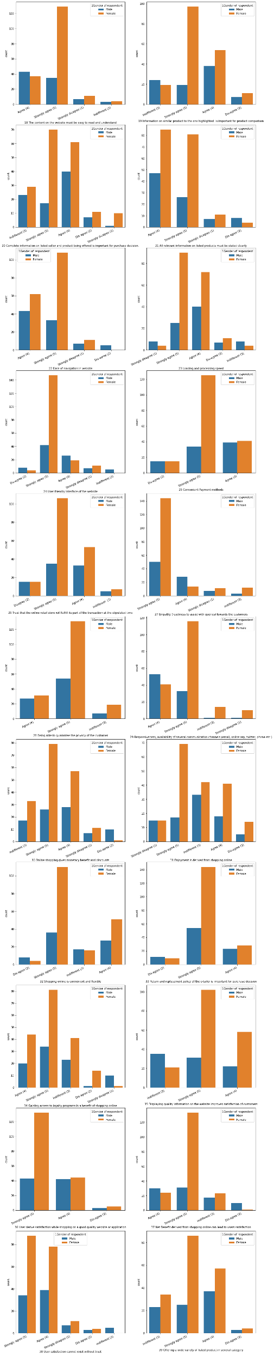
(iii)Reviews about ease of accessing , responsive benefits, customer satisfaction, product information etc.
The Fig.I 50% of customers strongly agree for website being easy to read and understand.
Fig.2 Majority of customers strongly agree and agree for information on similar product to the one highlighted is important for product comparison..

Slide 12
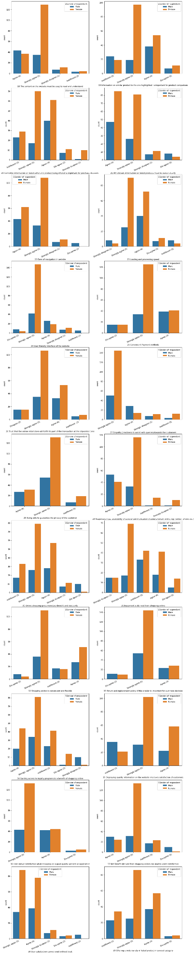
The Fig.I 50% of customers strongly agree for website being easy to read and understand.
Fig.2 Majority of customers strongly agree and agree for information on similar product to the one highlighted is important for product comparison..

Slide 13
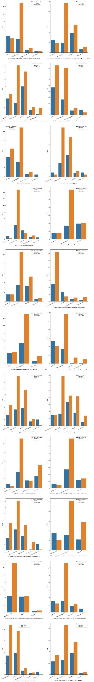
50% of customers strongly agree for user friendly interface website and convenient payment method

Slide 14
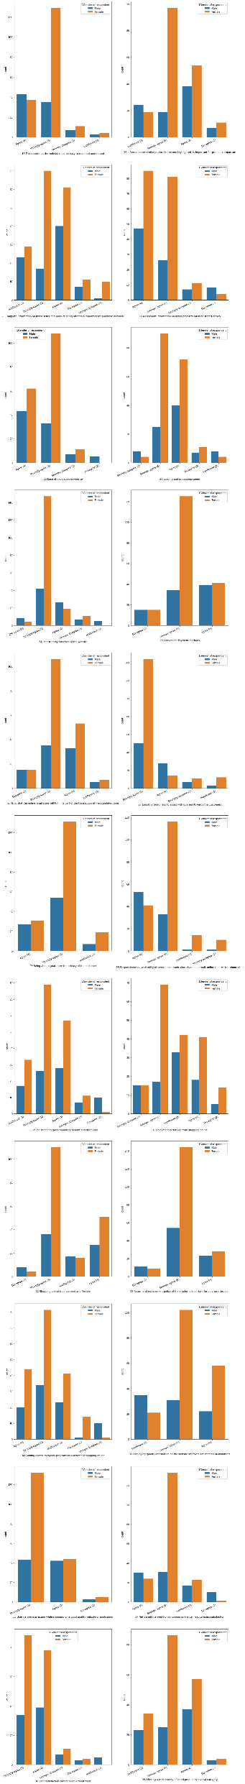
Customers strongly agree and agree with online shopping giving monetary benefits and discount
Though majority of customers strongly agree of enjoying the online shopping also noticeable number of customers strongly disagree and diasagree over enjoyment derived from shopping online.

Slide 15
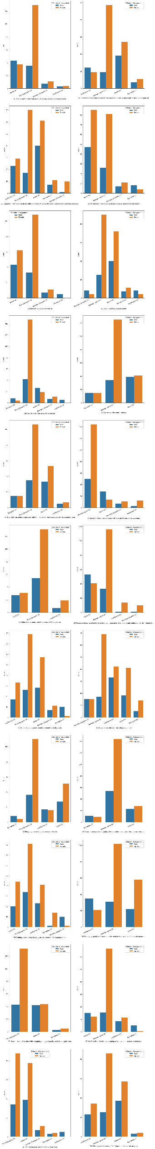
Customers strongly agree and agree that online shopping is convenient and flexible, very few dis-agree over this statement.
Return and replacement policy of the e-tailer is important for purchase decision is strongly agreed by very large number of customers. Very few dis-agree over this

Slide 16
(iv) Preferred websites/online store on site performance,offers,relaiblity,quickness,delivery,security,payment mode etc.

Slide 17
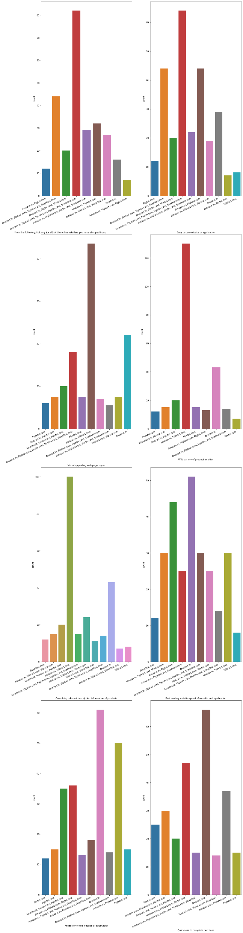
Majority of customers have shopped from all the below mentioned retailers and consider easy to use these websites too.
( Amazon,Flipkart,Paytm,Myntra and snapdeal)

Slide 18

More than 50% of customers consider Amazon and flipkart as more visually appealing webpage layout and have wild variety of product offer

Slide 19
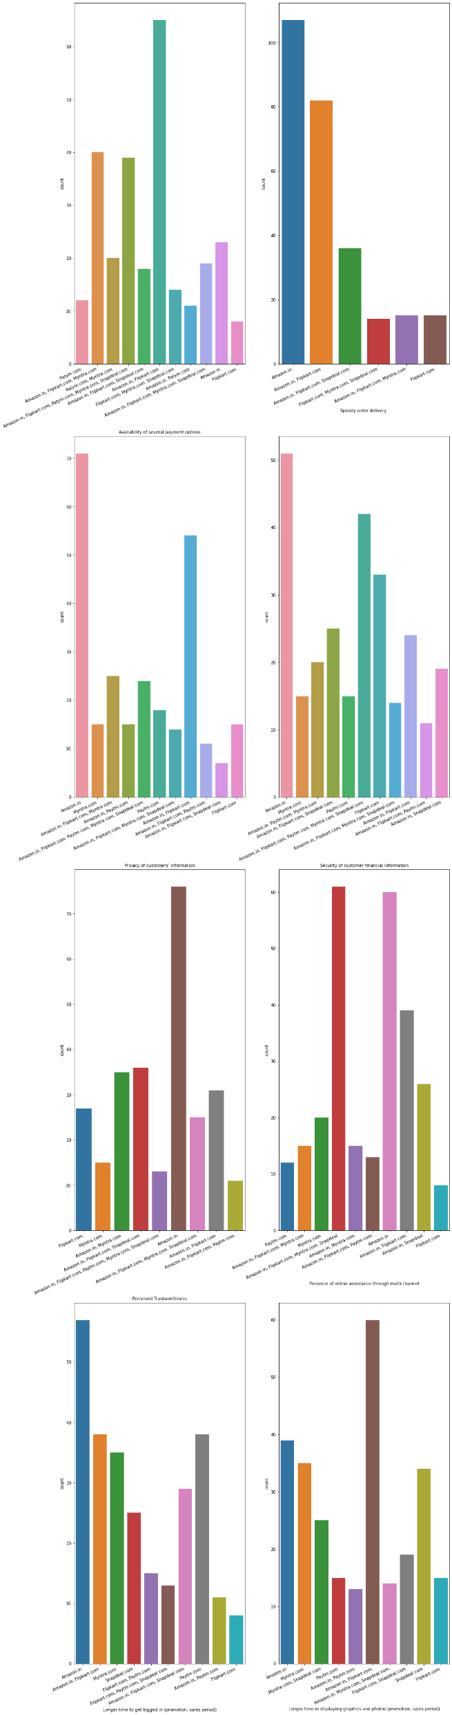
Amazon and flipkart have availability of several payment option according to most of cumstomers .
Amazon leads all online shoppers in speedy order delivery along with flipkart next to it in delivery time.

Slide 20
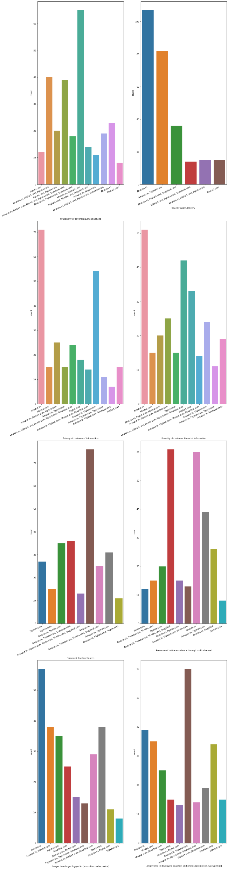
Amazon leads all e-tailers in keeping the privacy of customers information ,flipkart is next to amazon in same.
Customers consider amazon handles security of their financial information best compared other e-tailers

Slide 21
THANK YOU !!!!!

